Slide 1

Open source quality control and quality management
FRAME
Preservation and digitization of audiovisual media
June 18-22

Slide 2
Open source quality control and quality management
MediaArea
Open source software company focused on digital media analysis.

Slide 3
Open source quality control and quality management
Why quality control is important?

Slide 4
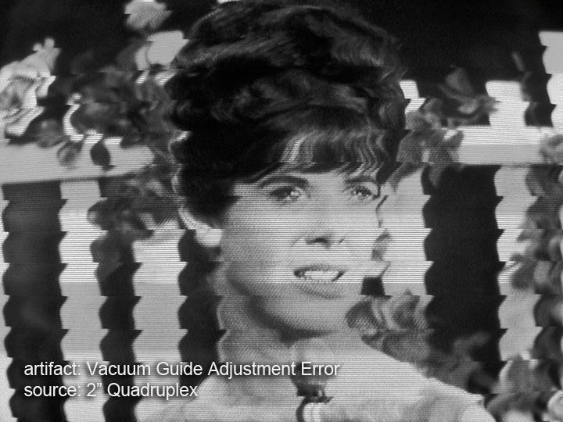

Why quality control is important?
If you don’t handle that now, content is definitely partially lost.

Slide 5
Why quality control is important?
Your digital copy provider is available now
  In the future, your content provider may have disappeared, trashed content…
The original tape is still there, but for how long?
  The original tape is still there, but for how long?
  Or your tape becomes no more readable.

Slide 6
Why quality control is important?
Easier to catch quality issues and fix them now than later
  When someone else discovers quality issues, it may be too late.

Slide 7
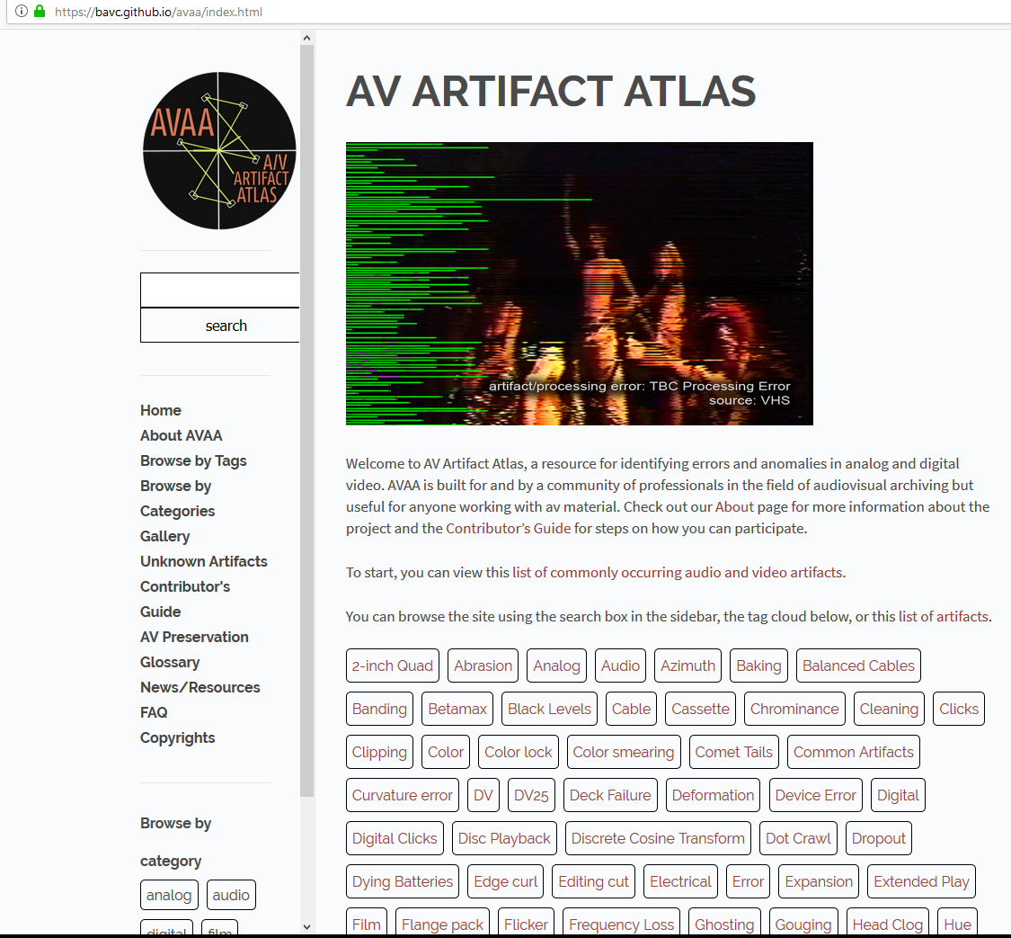
Why quality control is important?
You are not alone
Example of online support:
  AV Artifact Atlas, a resource for identifying errors and anomalies in analog and digital video. AVAA is built for and by a community of professionals in the field of audiovisual archiving but useful for anyone working with av material.

Slide 8
Why quality control is important?
You are not alone
Example of symposiums:
  “No Time To Wait” symposiums are free events focused on open media, open standards, and digital audiovisual preservation.
  Symposium program is made by archivists, who present how they work and the associated (open source) tools.
  Organization of symposiums has a cost.
  - Hosting granted by a main sponsor
  - Other archives or vendors may provide additional financial support
  “No Time To Wait” 2018 will be at British Film Institute on October 25-26.
  Other sponsors are AV Preservation by reto.ch, Centre national de l’audiovisuel Luxembourg (CNA) and the International Federation of Film Archives (FIAT/IFTA)

Slide 9
Open source quality control and quality management
Overview of open source

Slide 10
Overview of open source
The archival domain
Relatively small market (niche)
Off-the-shelf products often focus on different use cases
Highly specialized demands
  High potential for vendor dependence...

Slide 11
Overview of open source
Proprietary tools and formats are linked to one, and only one, vendor
  If vendor disappears, it is impossible to get bug fixes
  Without source code, you can not adapt yourself to new platforms: are you sure you’ll be able to run the software in 100 years?
  Vendor decides on the new features
  Are you big enough for making the vendor develop your prefered feature?

Slide 12
Overview of open source
The four freedoms of open source (a.k.a. free software)
The freedom to run the program as you wish, for any purpose
The freedom to study how the program works, and change it so it does your computing as you wish
The freedom to redistribute copies so you can help your neighbor
  The freedom to distribute copies of your modified versions to others

Slide 13
Overview of open source
You are no more tied to only one vendor
  YOU decide of the new features
  If you don’t like anymore what your supplier does, just change, YOU decide
  For small project, usually one developer, but YOU can fork if it does not go as you want.
  For bigger projects, YOU may decide between different competitors for new development or support.

Slide 14
Overview of open source
Reusability of existing solutions
Free choice of (local) support/suppliers
No black-box
Common tools/codebase = larger userbase
  Less "forced" upgrades

Slide 15
Overview of open source
Benefits of paying for open source software
Better support/updates
Pooling resources
Designed for your use-cases
Overall better cost-effectiveness
  Public money = public solution?

Slide 16
Overview of open source
Open source does not mean lack of professional support:
Support contracts
Paid installation/integration
Hire developers
Non-financial contributions:
Documentation
Testing / bug-reports
  Helping others

Slide 17
Overview of open source
A real-world example: The lossless video codec FFV1
Austrian National Archive (Mediathek) wanted to do lossless digital video archiving
Not satisfied with existing products (Interoperability issues)
Found FFV1 in FFmpeg: Excellent codec, but we wanted/needed more...
Contacted and hired a FFV1 developer
Other parties involved for advices (pooled resources)
Budget calculated in reference to costs of proprietary alternatives
Now FFV1 version 3: faster and integrity-aware
Important: published our experiences with FFV1
So: other archives using FFV1 now profit from improvements, too!

Slide 18
Overview of open source
  Quality of tools
  Chicken and egg: if everyone waits, nothing happens
  We start with needs easy to handle and we create dedicated open source tools
  Tools become bigger, step by step, when more people join
  YOU can decide about participating in lowering the overall cost for archives.

Slide 19
Overview of open source
Funding:
Driven by user requests
Most of tools were funded after a need is detected by users
Why paying for something you don't control? (is your current choice future proof?)
Everyone (you included) can develop or sponsor a development
You can fork if you think you have a better idea than others

Slide 20
Open source quality control and quality management
Overview of QCTools

Slide 21

Overview of QCTools
Helps users analyze and understand their digitized video files
through use of audiovisual analytics and filtering

Slide 22
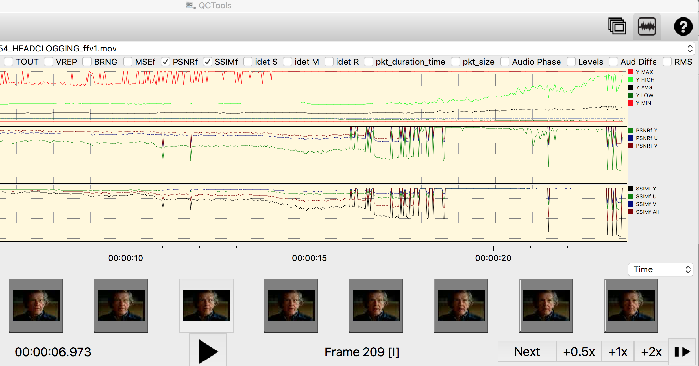
Overview of QCTools

Slide 23
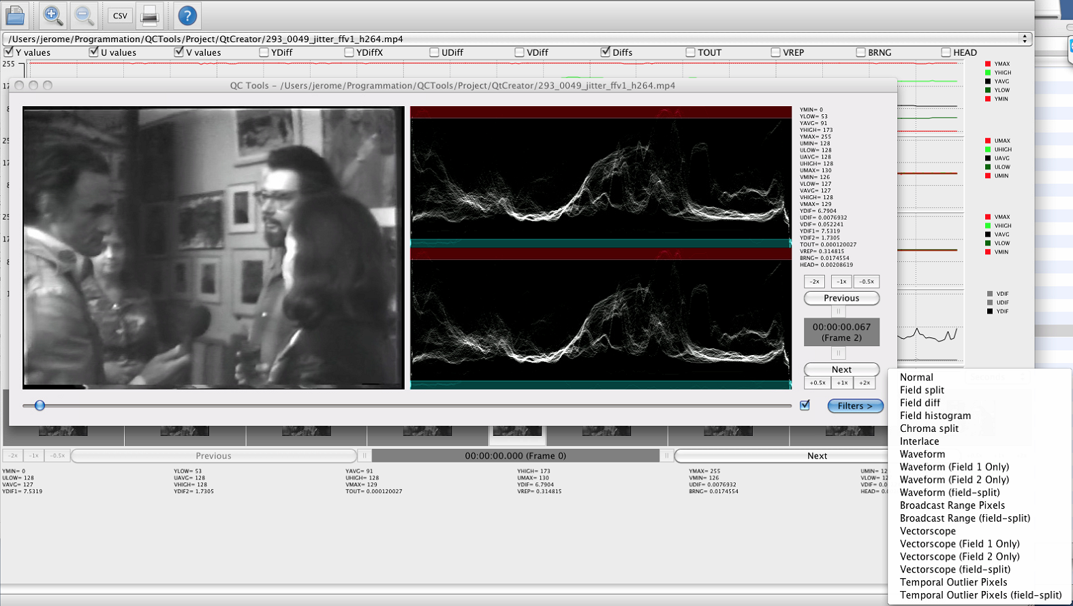
Overview of QCTools

Slide 24
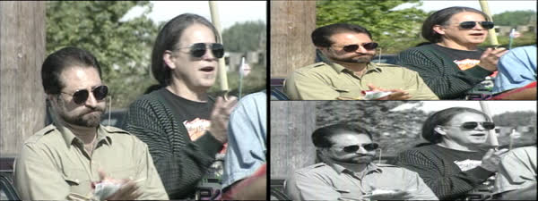
Overview of QCTools
Help in detecting issues. Example with field 2 missing color.

Slide 25
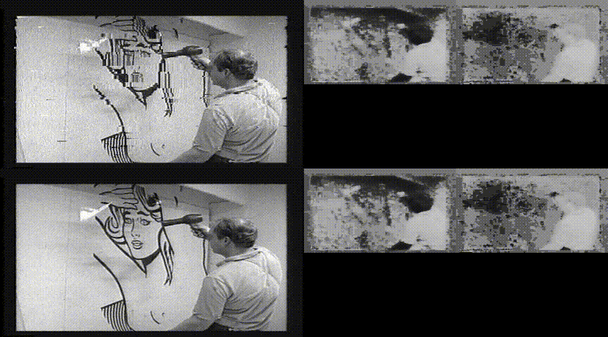
Overview of QCTools
Only 1 field has issues.

Slide 26
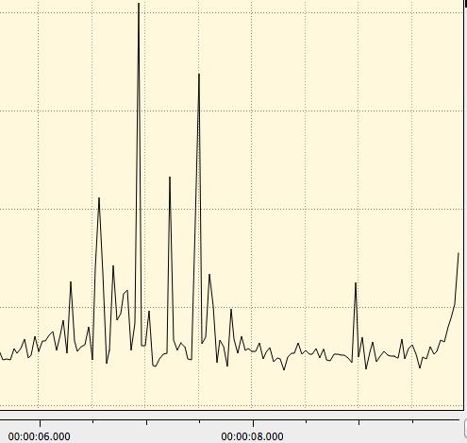
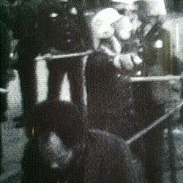
Overview of QCTools
Example of drop out.
Dropout is e.g. a brief loss of RF caused by a media defect such as a scratch on the media surface.
Can be detected through “TOUT” graph.

Slide 27
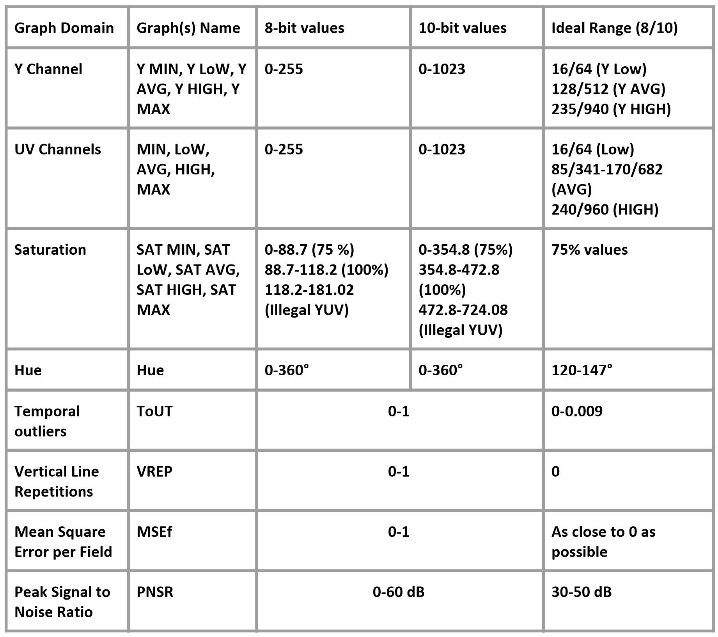
Overview of QCTools

Slide 28
Open source quality control and quality management
Overview of MediaConch

Slide 29

Overview of MediaConch
MediaConch is a conformance checker
Implementation checker
Policy checker
Reporter
Fixer

Slide 30


Overview of MediaConch
How it was developed:
Initial development sponsored by European Union (PREFORMA project)
Focused on FFV1 and Matroska.
We added all formats supported by MediaInfo to the policy checker.

Slide 31
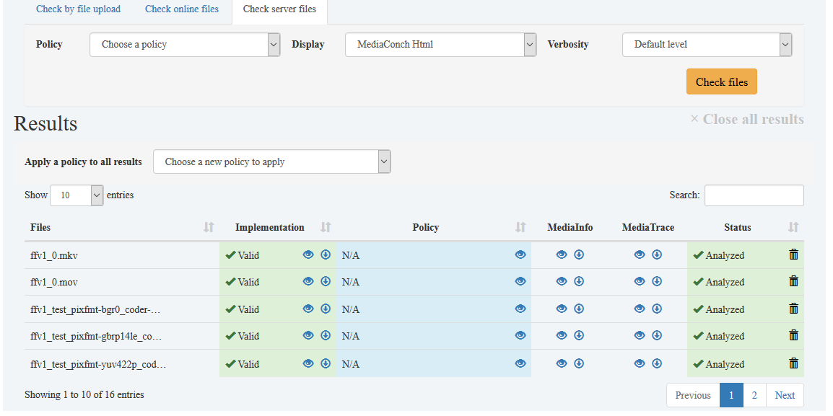
Overview of MediaConch
Implementation and Policy reporter

Slide 32
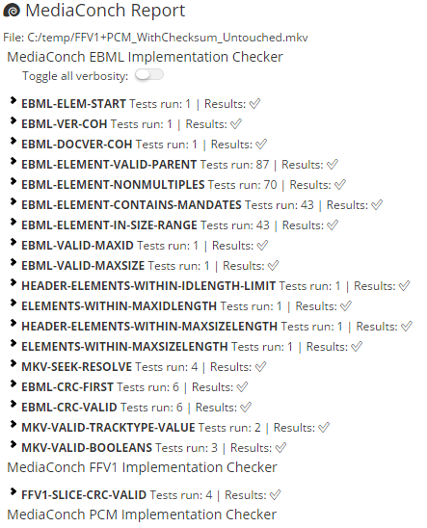
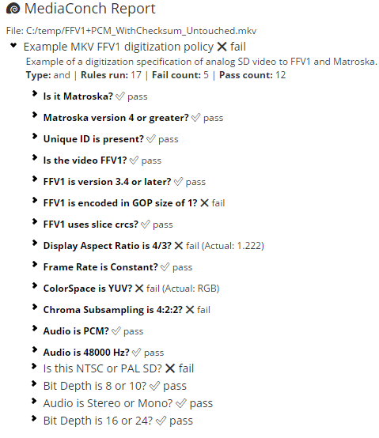
Overview of MediaConch
Implementation report: Policy report:
  Compared to a specification
  or
  Compared to your policy

Slide 33
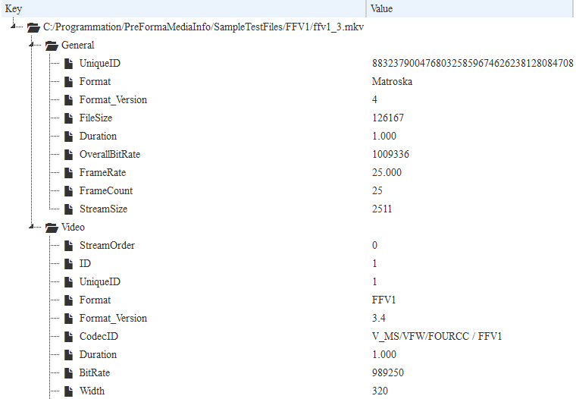
Overview of MediaConch
  General information
  about your files

Slide 34
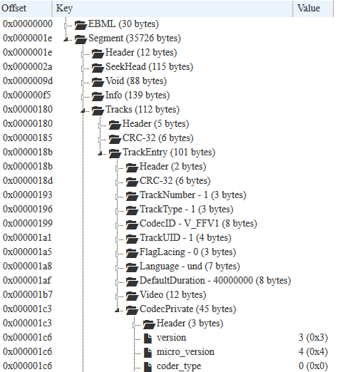
Overview of MediaConch
  Inspect your files

Slide 35
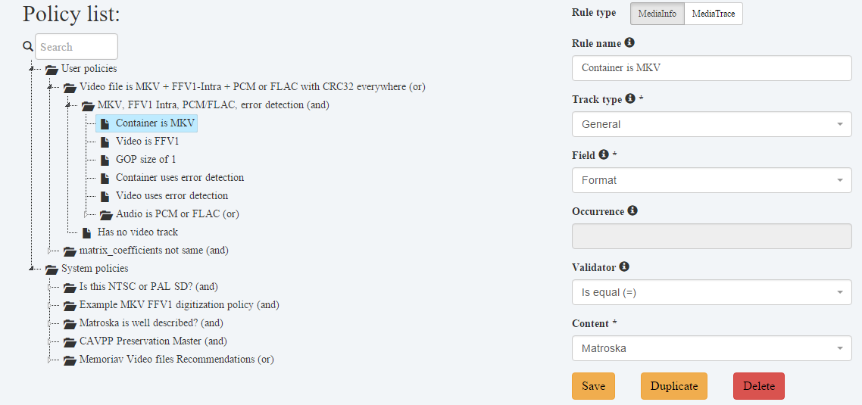
Overview of MediaConch
  Policy editor

Slide 36
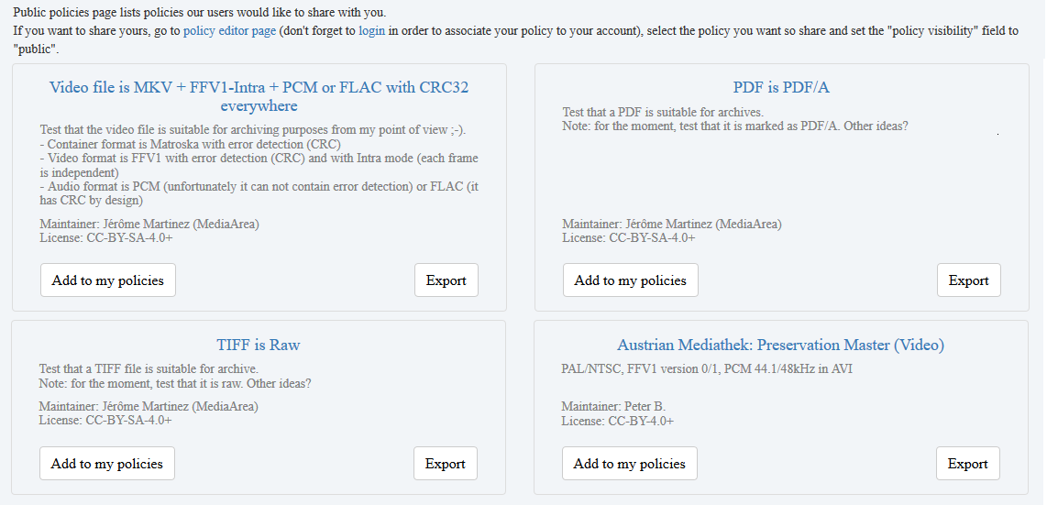
Overview of MediaConch
  Public policies

Slide 37
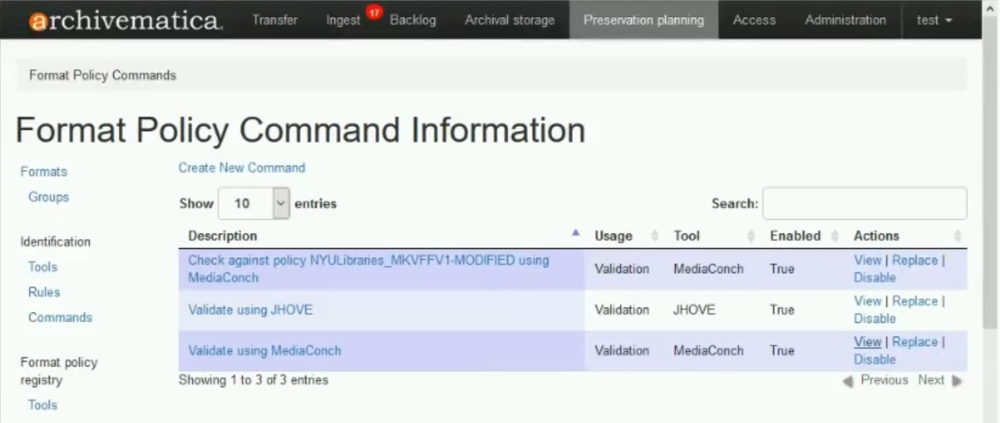
Overview of MediaConch
  Integration
  Archivematica is an integrated suite of open-source software tools that allows users to process digital objects from ingest to access in compliance with the ISO-OAIS functional model

Slide 38
Overview of MediaConch
Supported formats:
Priorities for the implementation checker:
Matroska
FFV1
Can accept any format supported by MediaInfo for the policy checker
MXF + JP2k
QuickTime/MOV
Audio files (WAV, BWF, AIFF...)
...

Slide 39
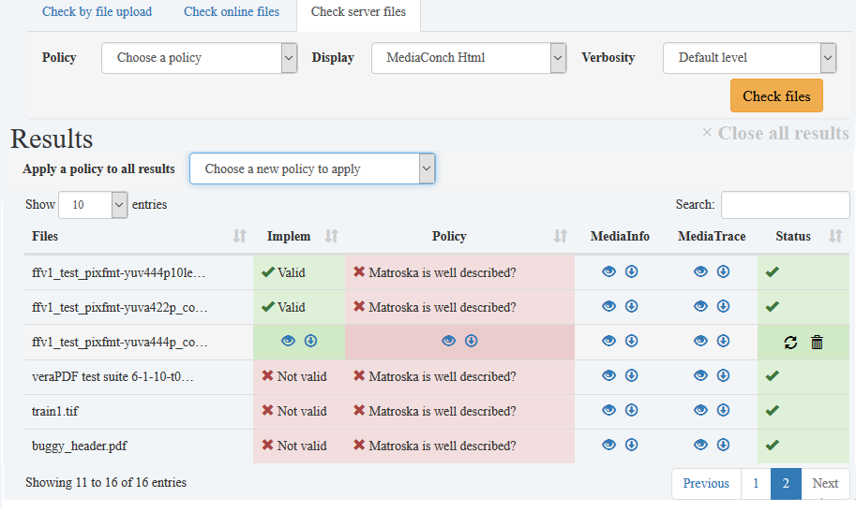
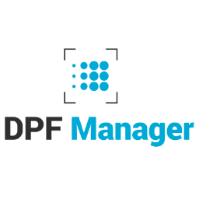

Overview of MediaConch
Support of plugins

Slide 40

Overview of MediaConch
Versatile
Input can be from:
Files (local/network)
FTP/FTPS/SFTP
HTTP/HTTPS
Amazon S3
Binaries are provided for:
Windows
Mac (Homebrew users:"brew install mediaconch", that's all!)
Linux (Ubuntu, Debian, Fedora, OpenSUSE...)

Slide 41
Overview of MediaConch
And after PREFORMA sponsorship? It depends on you!
This is open source
Driven by user requests
Everyone can develop or sponsor a development
Potential features:
Support of tests for your prefered format (MOV? MXF? JP2k? WAV?)
Integration in your workflow
...

Slide 42
Open source quality control and quality management
Other tools

Slide 43
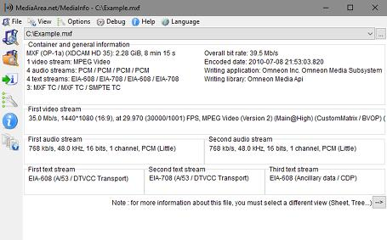
MediaInfo
Convenient unified display of the most relevant technical and tag data for video and audio files.
Output: text, XML, HTML, PBCore, EBUCore, NISO Z39.87...
Container: format, profile, commercial name of the format, duration, overall bit rate, writing application and library, title, author, director, album, track number, date, duration...
Video: format, codec id, aspect, frame rate, bitrate, color space, chroma subsampling, bit depth, scan type, scan order...
Audio: format, codec id, sample rate, channels, bit depth, language, bit rate...
Text: format, codec id, language of subtitle...
Chapters: count of chapters, list of chapters...

Slide 44
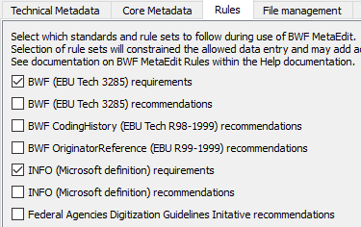
BWF MetaEdit
Supports embedding, validating, and exporting of metadata in Broadcast WAVE Format (BWF) files.
It supports the FADGI Broadcast WAVE Metadata Embedding Guidelines.

Slide 45
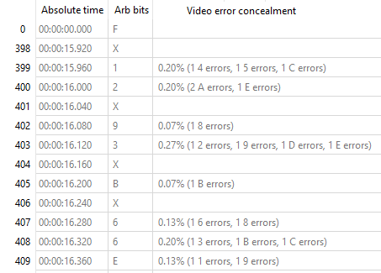
DV Analyzer
Technical quality control and reporting tool that examines DV streams in order to report errors in the tape-to-file transfer process, such as video error concealment information, invalid audio samples, timecode inconsistency, inconsistent use of arbitrary bits in video DIF blocks, and DIF structural problems. Also reports on patterns within DV streams such as changes in DV time code, changes in recording date and time markers, first and last frame markers within individual recordings, and more.

Slide 46
RAWcooked
Encodes RAW audio-visual data (DPX/TIFF) into a losslessly compressed file (no more unplayable TAR!)
Metadata accompanying the RAW data are preserved (reversibility)
Sidecar files, like MD5, LUT or XML, are in container attachments
Final package is 1.5-3x (usually 2x) smaller than DPX/TIFF
Checksum by "Cluster" (usually 1 second) at container level
Checksum by "Slice" (you choose how many per frame) at video level
Files are natively playable by lot of tools (FFmpeg, VLC...)
Save HDD/LTO space: either ~2x less cost for same redundancy or 2x more redundancy for ~ same cost
https://MediaArea.net/RAWcooked

Slide 47
Open source quality control and quality management
Practical examples

Slide 48
Stay in touch
MediaArea: https://MediaArea.net, @MediaArea_net
Jérôme Martinez: jerome@MediaArea.net
Slides: https://MediaArea.net/Events
  License: CC BY

