Slide 1




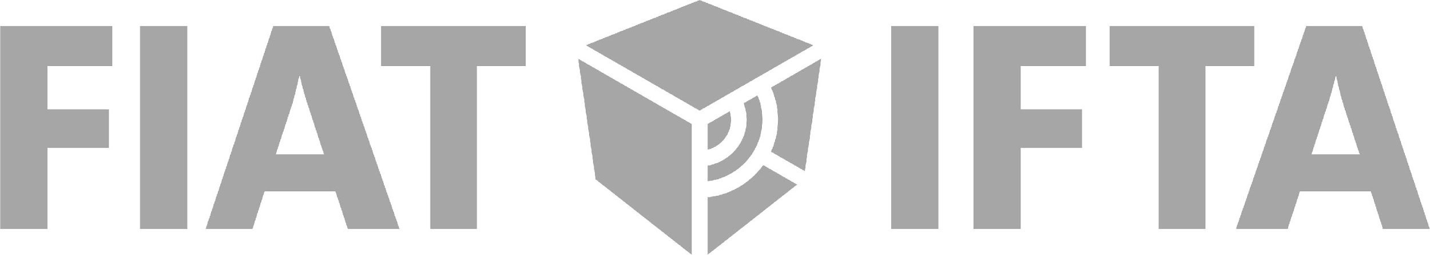
2021
FRAME tECH
An overview of an AV archive, from
physical assets management to digitization
and digital objects preservation.
17
19
22
24
&
17
/
11

Slide 2
Open Source Quality
Control and Quality
Management
FRAME Tech 2021 — Online Training Session

Slide 3
MediaArea
Open source team company focused on digital media analysis.
FRAME Tech 2021 — Online Training Session

Slide 4
Why quality control is important?
FRAME Tech 2021 — Online Training Session

Slide 5
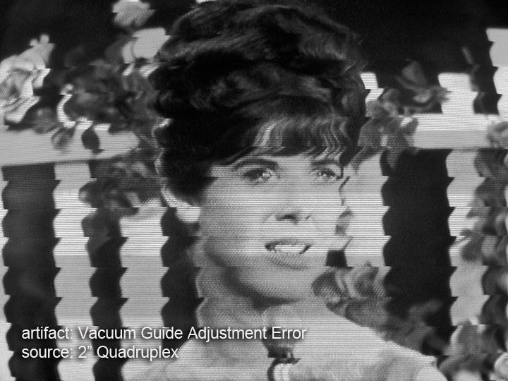
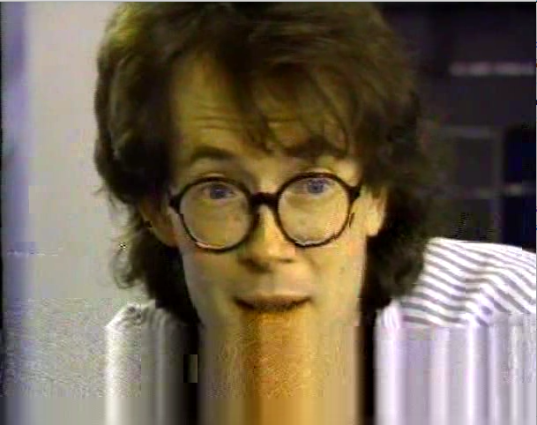
Why quality control is important?
If you don’t handle that now, content is definitely partially lost.
FRAME Tech 2021 — Online Training Session

Slide 6
Why quality control is important?
Your digital copy provider is available now
In the future, your content provider may have disappeared, trashed content…
The original tape is still there, but for how long?
The original tape is still there, but for how long?
Or your tape becomes no more readable.
FRAME Tech 2021 — Online Training Session

Slide 7
Why quality control is important?
Easier to catch quality issues and fix them now than later
When someone else discovers quality issues, it may be too late.
FRAME Tech 2021 — Online Training Session

Slide 8
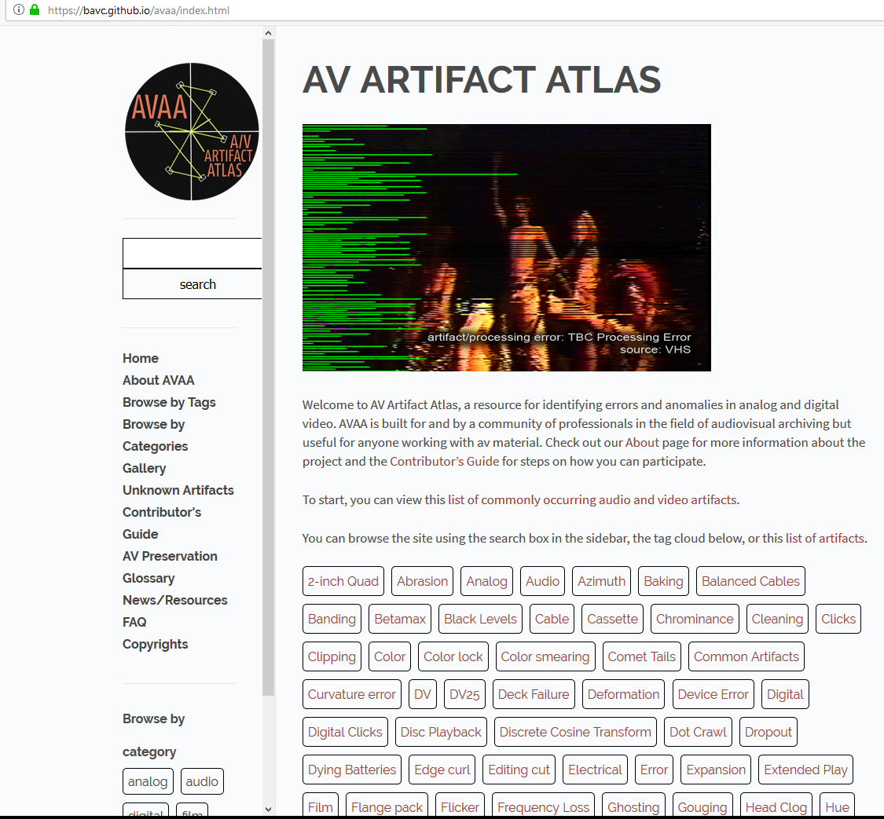
Why quality control is important?
You are not alone
Example of online support:
AV Artifact Atlas, a resource for identifying errors and anomalies in analog and digital video. AVAA is built for and by a community of professionals in the field of audiovisual archiving but useful for anyone working with av material.
https://www.avartifactatlas.com/
FRAME Tech 2021 — Online Training Session

Slide 9
Why quality control is important?
You are not alone
Example of symposiums:
“No Time To Wait” symposiums are free events focused on open media, open standards, and digital audiovisual preservation.
Symposium program is made by archivists, who present how they work and the associated (open source) tools.
Organization of symposiums has a cost.
- Hosting granted by a main sponsor
- Other archives or vendors may provide additional financial support
“No Time To Wait” 2021 will be at Sound & Vision in Amsterdam on December 8-10.
Other sponsors are AV Preservation by reto.ch, Centre national de l’audiovisuel Luxembourg (CNA), The National Library of Norway and the International Federation of Film Archives (FIAT/IFTA)
FRAME Tech 2021 — Online Training Session

Slide 10
Overview of open source
FRAME Tech 2021 — Online Training Session

Slide 11
Overview of open source
The archival domain:
Relatively small market (niche)
Off-the-shelf products often focus on different use cases
Highly specialized demands
High potential for vendor dependence...
FRAME Tech 2021 — Online Training Session

Slide 12
Overview of open source
Proprietary tools and formats are linked to one, and only one, vendor
If the vendor disappears, it is impossible to get bug fixes
Without source code, you can not adapt yourself to new platforms: are you sure you’ll be able to run the software in 100 years?
Vendor decides on the new features
Are you big enough for making the vendor develop your prefered feature?
FRAME Tech 2021 — Online Training Session

Slide 13
Overview of open source
The four freedoms of open source (a.k.a. free software)
The freedom to run the program as you wish, for any purpose
The freedom to study how the program works, and change it so it does your computing as you wish
The freedom to redistribute copies so you can help your neighbor
The freedom to distribute copies of your modified versions to others
FRAME Tech 2021 — Online Training Session

Slide 14
Overview of open source
Reusability of existing solutions
Free choice of (local) support/suppliers
No black-box
Common tools/codebase = larger userbase
Less "forced" upgrades
FRAME Tech 2021 — Online Training Session

Slide 15
Overview of open source
Benefits of paying for open source software:
Better support/updates
Pooling resources
Designed for your use-cases
Overall better cost-effectiveness
Public money = public solution?
FRAME Tech 2021 — Online Training Session

Slide 16
Overview of open source
Open source does not mean lack of professional support:
Support contracts
Paid installation/integration
Hire developers
Non-financial contributions:
Documentation
Testing / bug-reports
Helping others
FRAME Tech 2021 — Online Training Session

Slide 17
Overview of open source
A real-world example: The lossless video codec FFV1 (RFC 9043)
Austrian National Archive (Mediathek) wanted to do lossless digital video archiving
Not satisfied with existing products (Interoperability issues)
Found FFV1 in FFmpeg: Excellent codec, but we wanted/needed more...
Contacted and hired a FFV1 developer
Other parties involved for advices (pooled resources)
Budget calculated in reference to costs of proprietary alternatives
Now FFV1 version 3: faster and integrity-aware
Important: we published our experiences with FFV1
So: other archives using FFV1 now profit from improvements, too!
FRAME Tech 2021 — Online Training Session

Slide 18
Overview of open source
Quality of tools
Chicken and egg: if everyone waits, nothing happens
We start with needs easy to handle and we create dedicated open source tools
Tools become bigger, step by step, when more people join
YOU can decide about participating in lowering the overall cost for archives.
FRAME Tech 2021 — Online Training Session

Slide 19
Overview of open source
Quality of tools
Chicken and egg: if everyone waits, nothing happens
We start with needs easy to handle and we create dedicated open source tools
Tools become bigger, step by step, when more people join
YOU can decide about participating in lowering the overall cost for archives.
FRAME Tech 2021 — Online Training Session

Slide 20
Overview of open source
Quality of tools
Chicken and egg: if everyone waits, nothing happens
We start with needs easy to handle and we create dedicated open source tools
Tools become bigger, step by step, when more people join
YOU can decide about participating in lowering the overall cost for archives.
FRAME Tech 2021 — Online Training Session

Slide 21
QCTools
FRAME Tech 2021 — Online Training Session

Slide 22

QCTools
Tool that helps users analyze and understand their digitized video files through use of audiovisual analytics and filtering.
FRAME Tech 2021 — Online Training Session

Slide 23
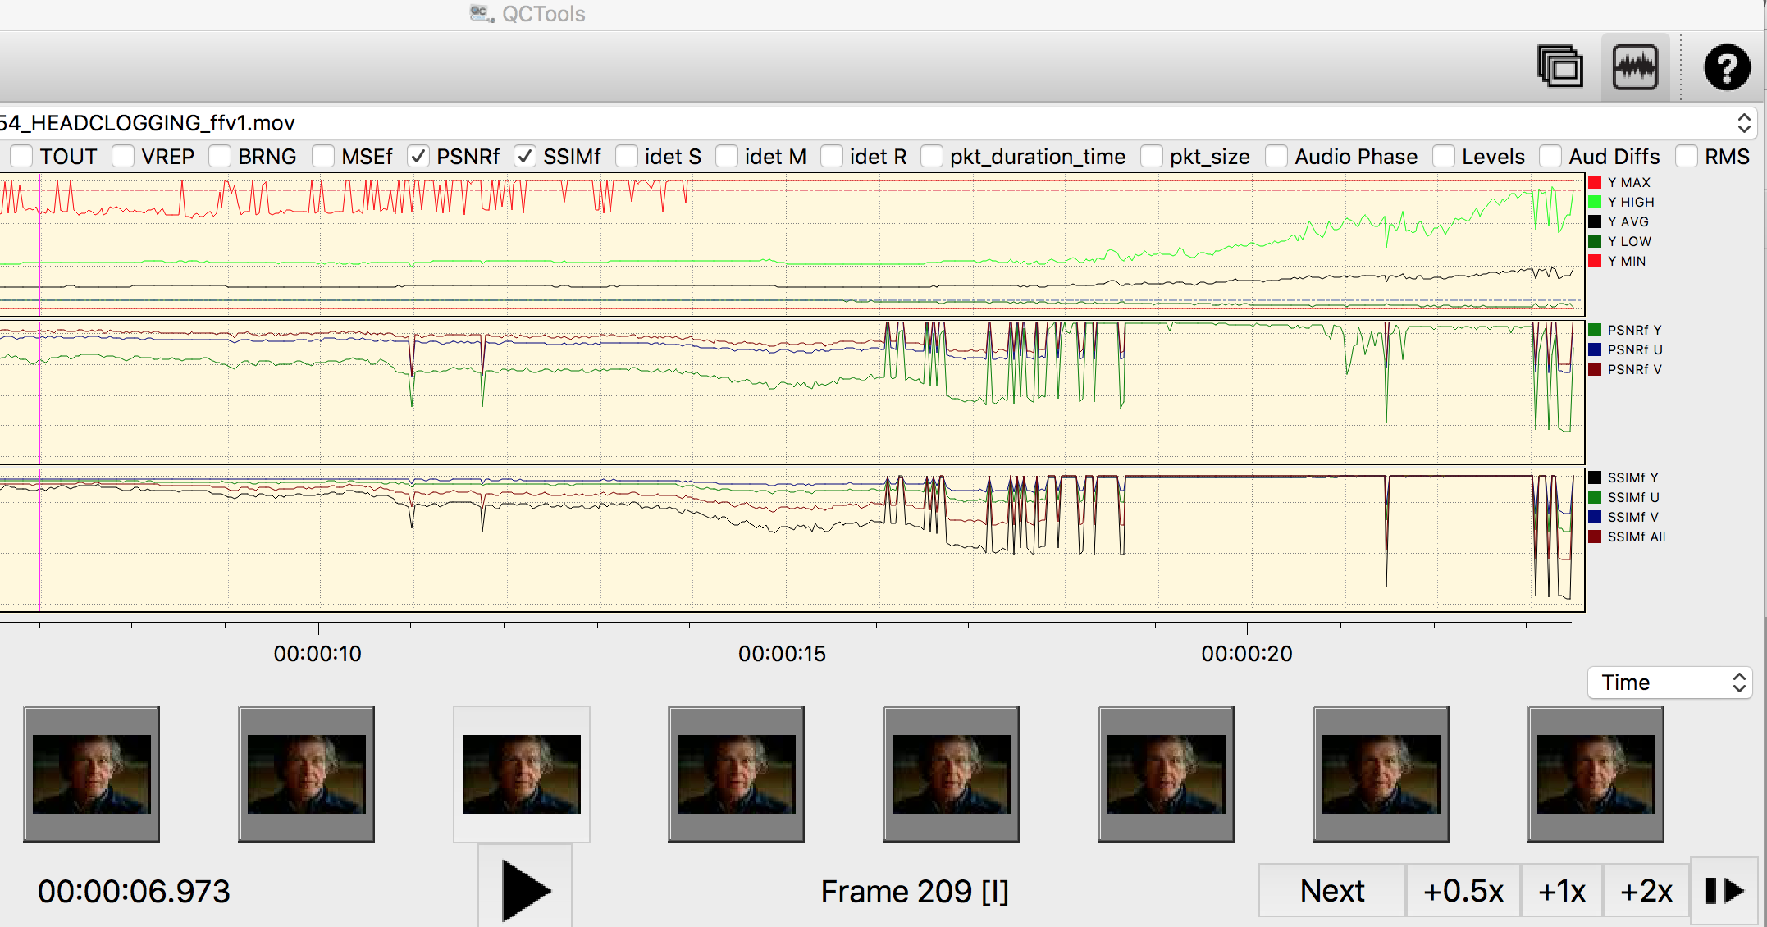
QCTools
FRAME Tech 2021 — Online Training Session

Slide 24
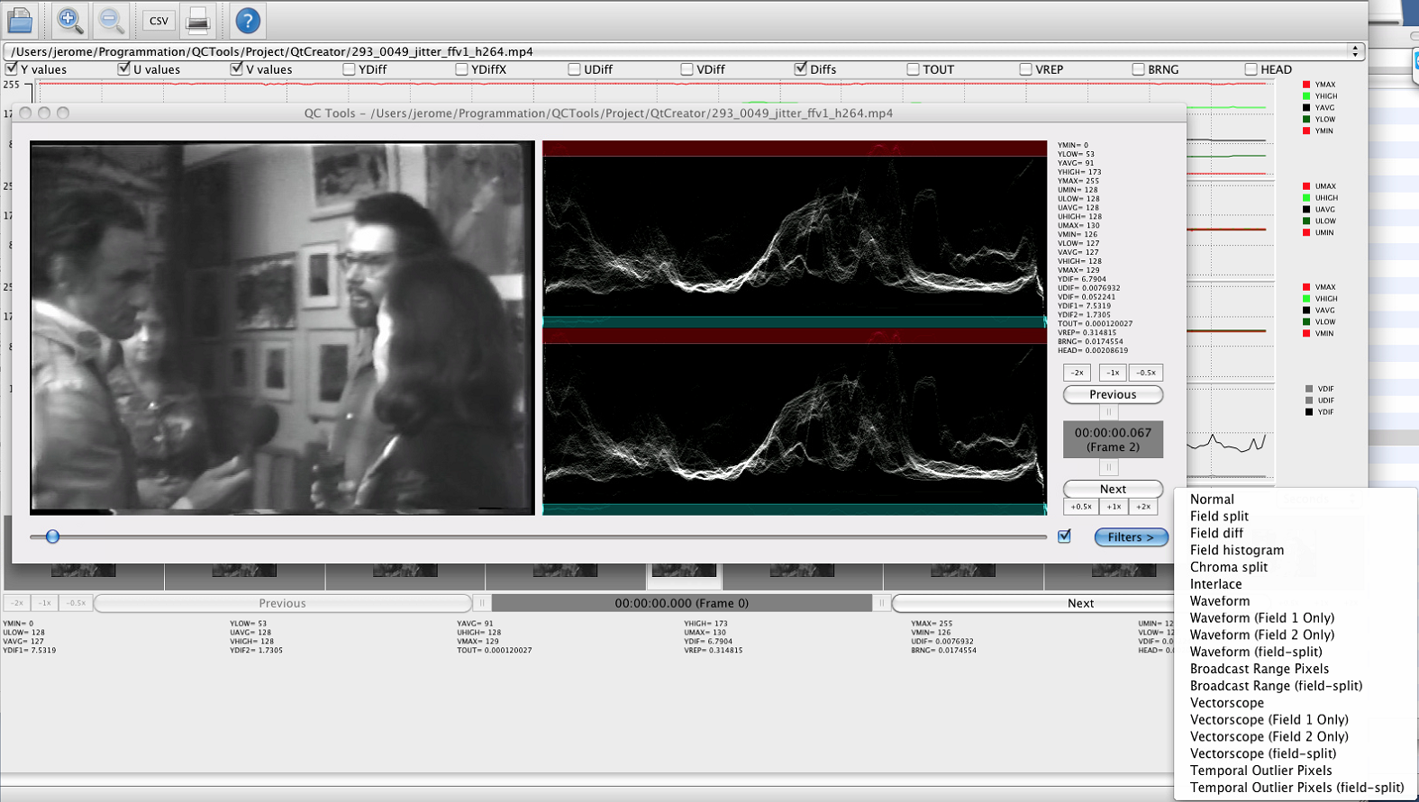
QCTools
FRAME Tech 2021 — Online Training Session

Slide 25
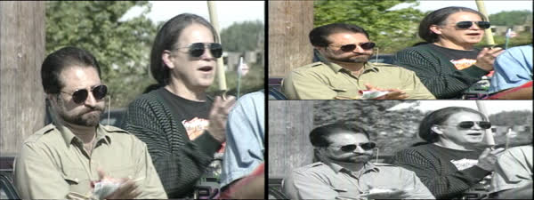
QCTools
Help in detecting issues. Example with field 2 missing color.
FRAME Tech 2021 — Online Training Session

Slide 26
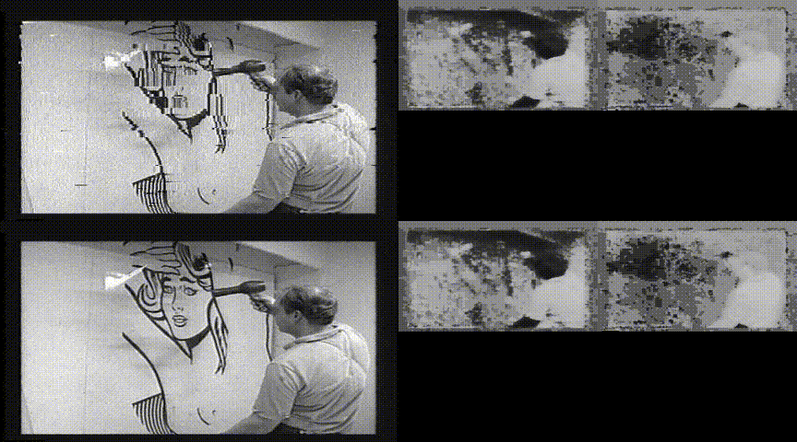
QCTools
Only 1 field has issues.
FRAME Tech 2021 — Online Training Session

Slide 27
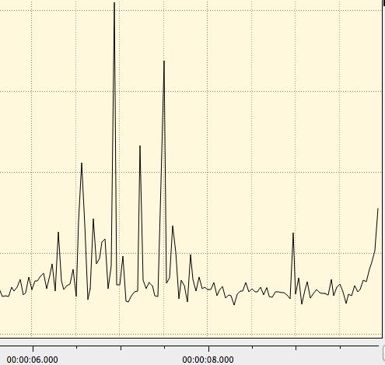
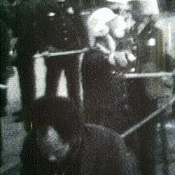
QCTools
Example of drop out.
Dropout is e.g. a brief loss of RF caused by a media defect such as a scratch on the media surface.
Can be detected through “TOUT” graph.
FRAME Tech 2021 — Online Training Session

Slide 28
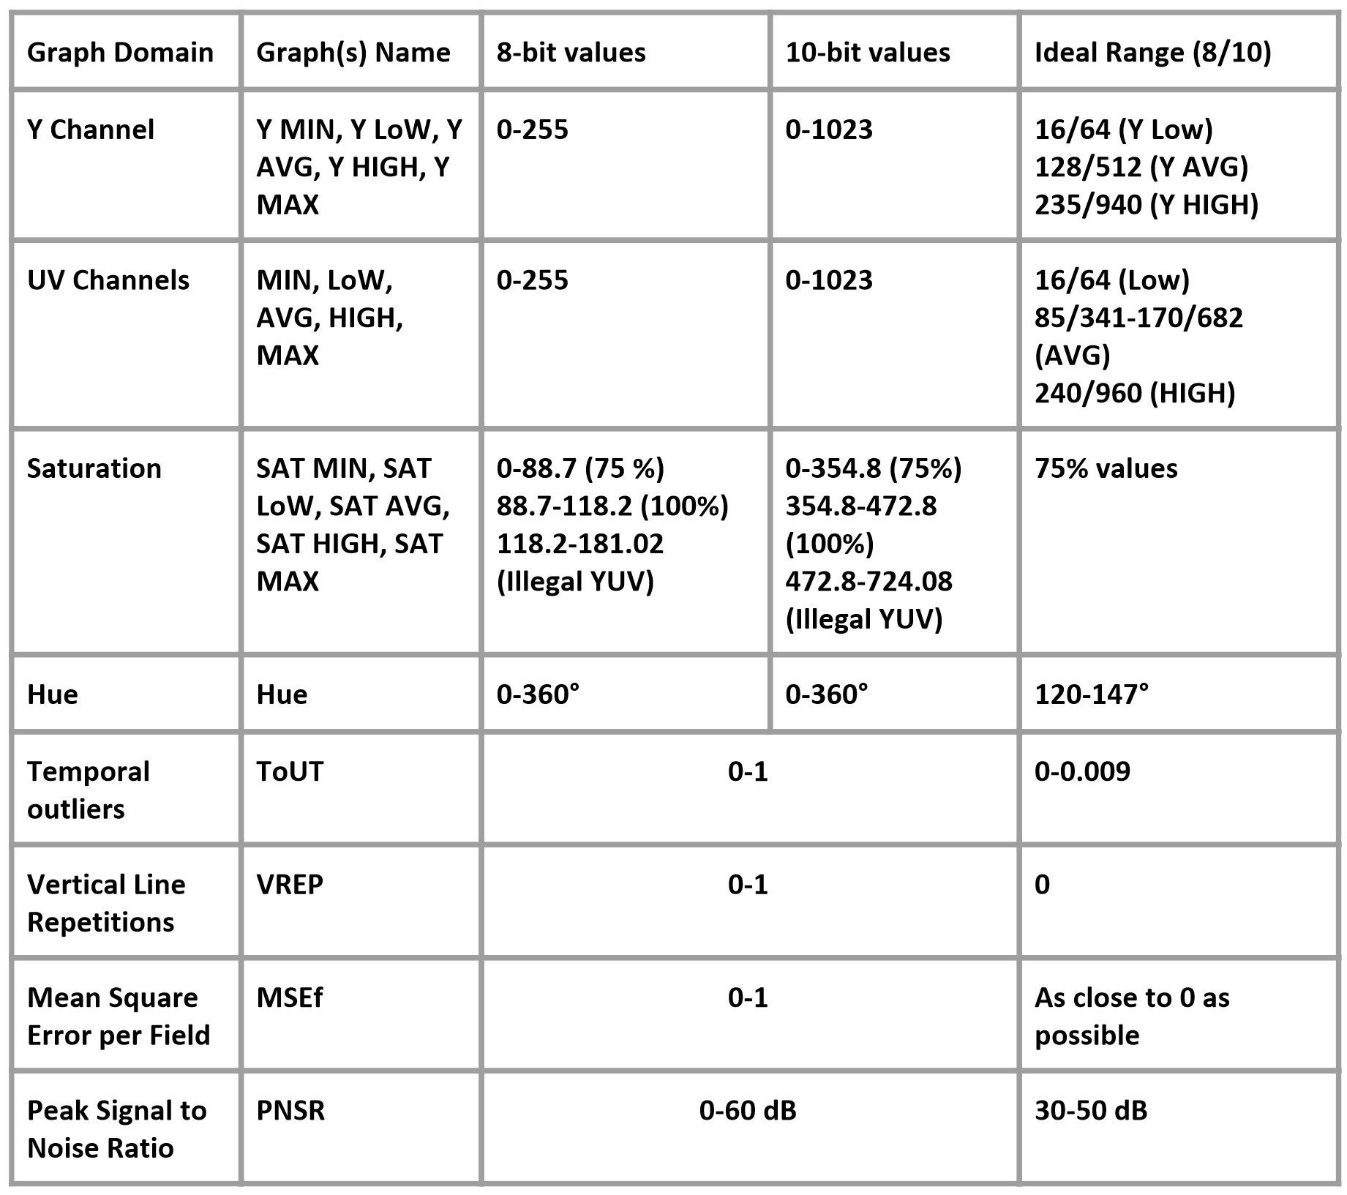
QCTools
FRAME Tech 2021 — Online Training Session

Slide 29
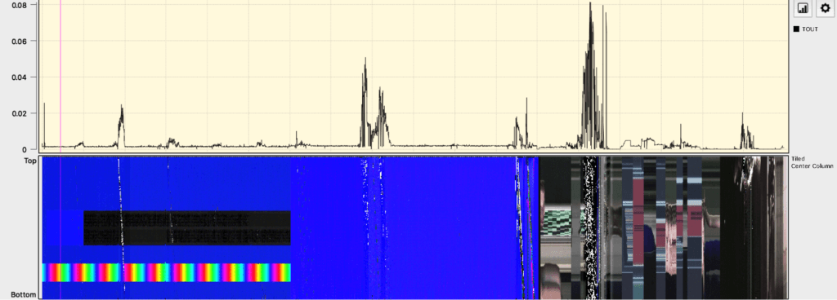
QCTools
In new version 1.2, sponsored by Technische Informationsbibliothek (TIB): panels
This allows a way to provide a visual impression of the content against the traditional QCTools graphs
FRAME Tech 2021 — Online Training Session

Slide 30
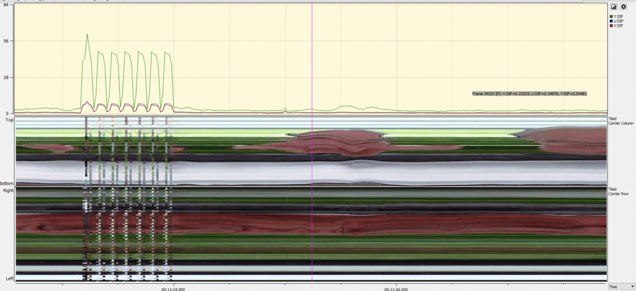
QCTools
How to catch e.g. vertical lines in a digitized digital betacam:
What we have with QCTools
FRAME Tech 2021 — Online Training Session

Slide 31
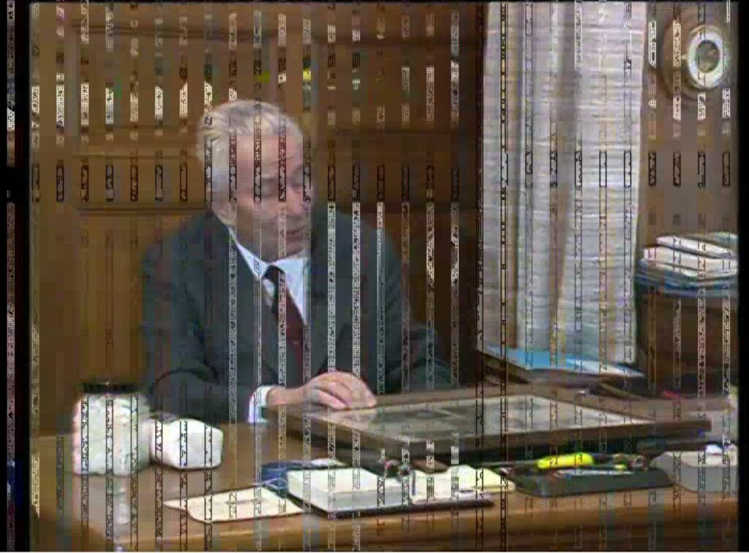
QCTools
How to catch e.g. vertical lines in a digitized digital betacam:
The scanned image!
FRAME Tech 2021 — Online Training Session

Slide 32
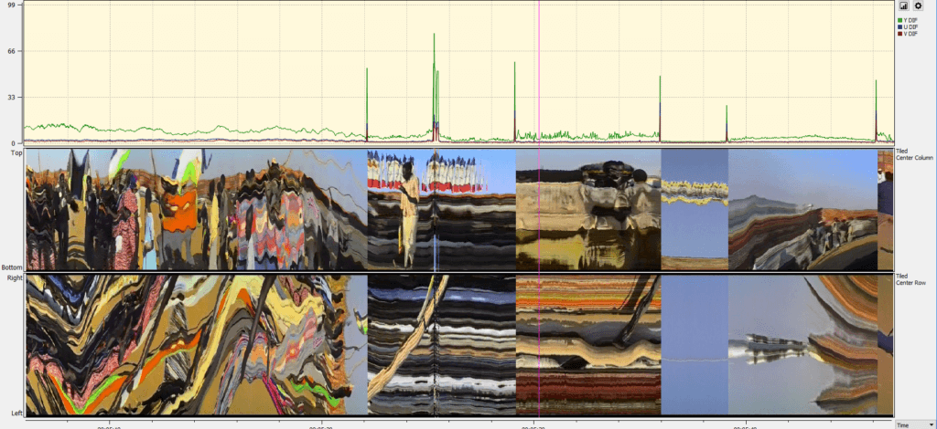
QCTools
Big differences in luminance/colors may be normal (scene change), but sometimes it is not, panels helps to quickly see if there is a scene change
FRAME Tech 2021 — Online Training Session

Slide 33
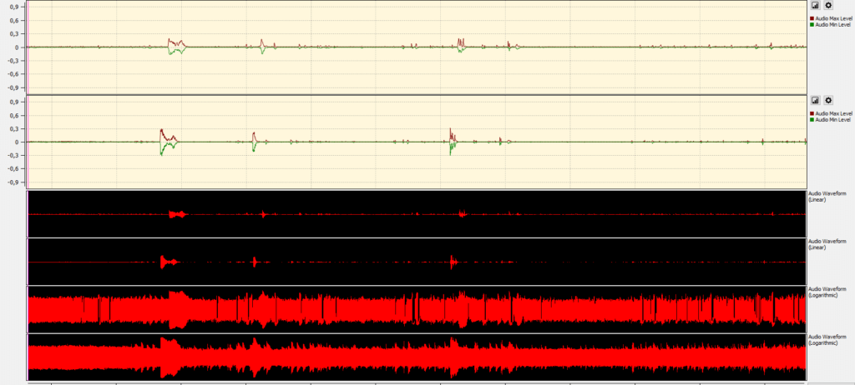
QCTools
Catching audio alignment when the soundtrack is in multiple forms e.g. optic and magnetic.
FRAME Tech 2021 — Online Training Session

Slide 34
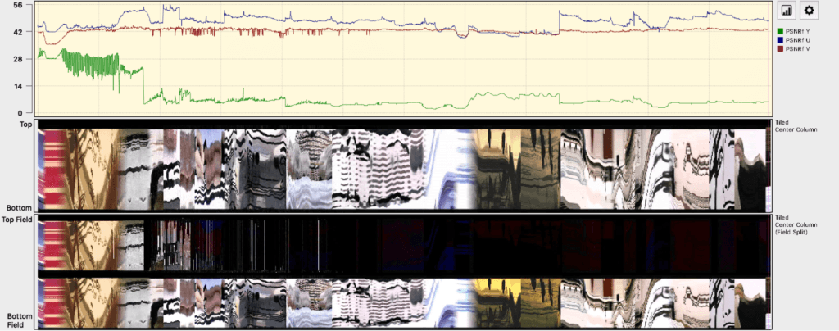
QCTools
Field split issue detection was manual in the previous versions of QCTools. Now more automated.
FRAME Tech 2021 — Online Training Session

Slide 35
QCTools
And more automation with a command line tool (qcli) for preprocessing files.
FRAME Tech 2021 — Online Training Session

Slide 36
MediaConch
FRAME Tech 2021 — Online Training Session

Slide 37

MediaConch
MediaConch is a conformance checker
Implementation checker
Policy checker
Reporter
Fixer
FRAME Tech 2021 — Online Training Session

Slide 38


MediaConch
How it was developed:
Initial development sponsored by European Union (PREFORMA project)
Focused on FFV1 and Matroska.
We added all formats supported by MediaInfo to the policy checker.
FRAME Tech 2021 — Online Training Session

Slide 39
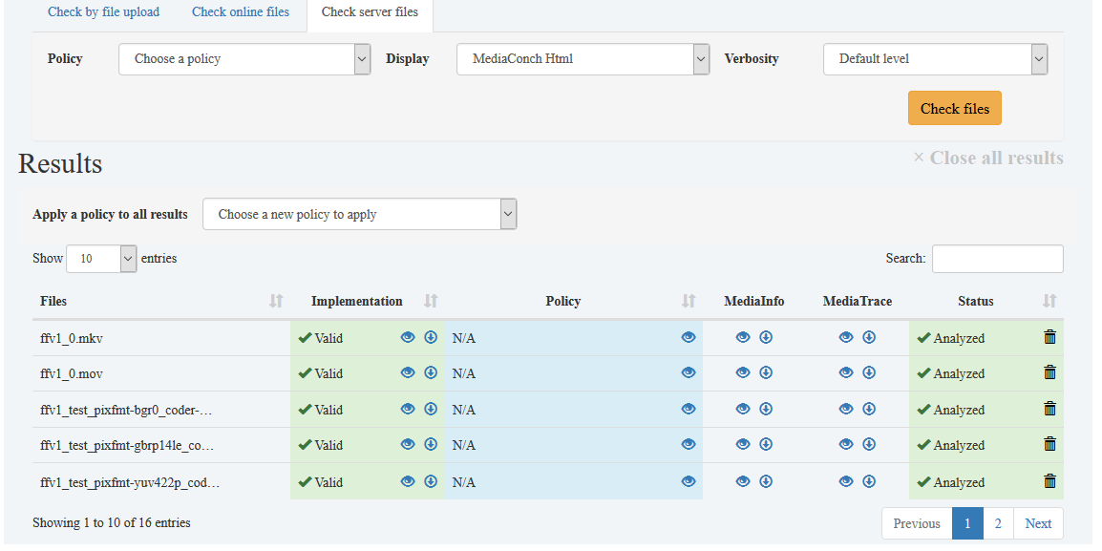
MediaConch
Implementation and Policy reporter
FRAME Tech 2021 — Online Training Session

Slide 40
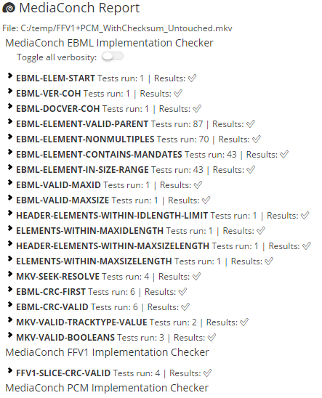
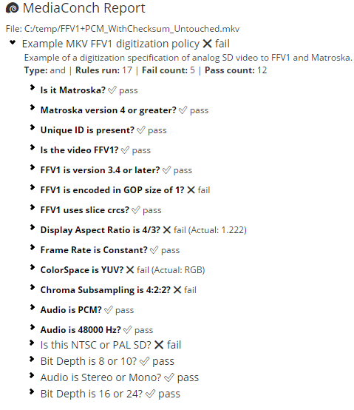
MediaConch
Implementation report: Policy report:
  Compared to a specification
  or
  Compared to your policy
FRAME Tech 2021 — Online Training Session

Slide 41
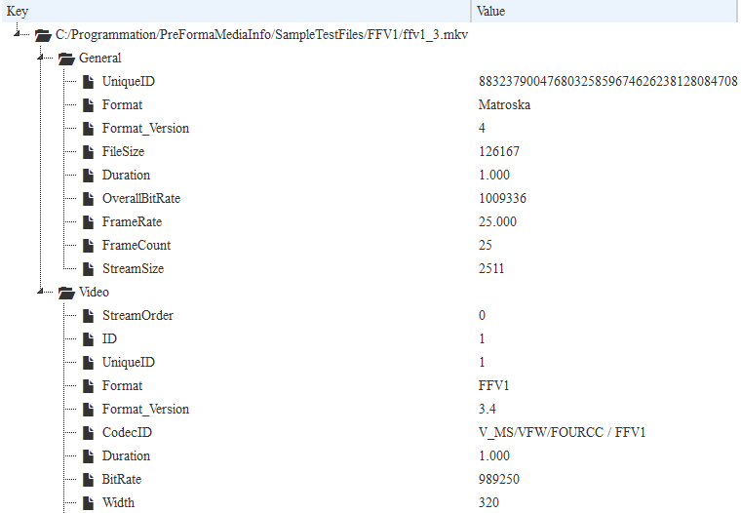
MediaConch
  General information
  about your files
FRAME Tech 2021 — Online Training Session

Slide 42
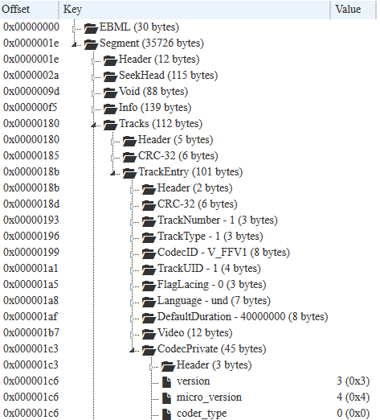
MediaConch
  Inspect your files
FRAME Tech 2021 — Online Training Session

Slide 43
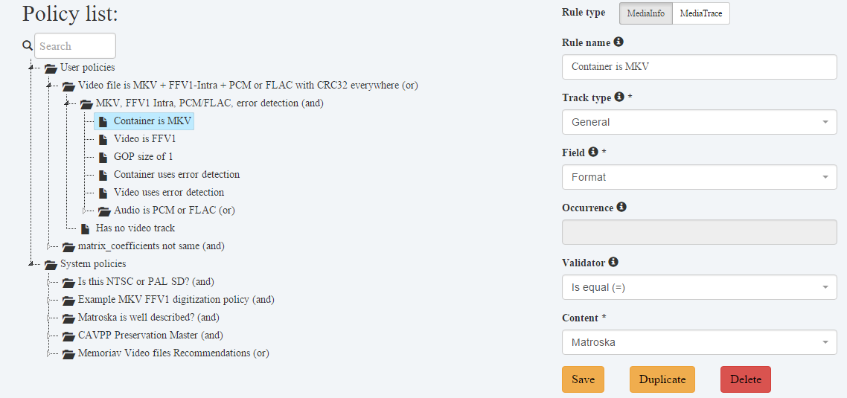
MediaConch
  Policy editor
FRAME Tech 2021 — Online Training Session

Slide 44
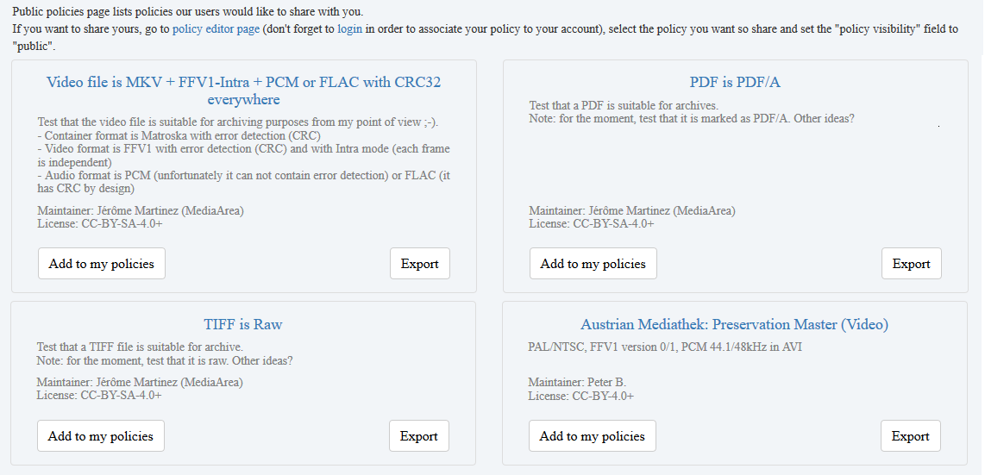
MediaConch
  Public policies
FRAME Tech 2021 — Online Training Session

Slide 45

DVRescue
FRAME Tech 2021 — Online Training Session

Slide 46
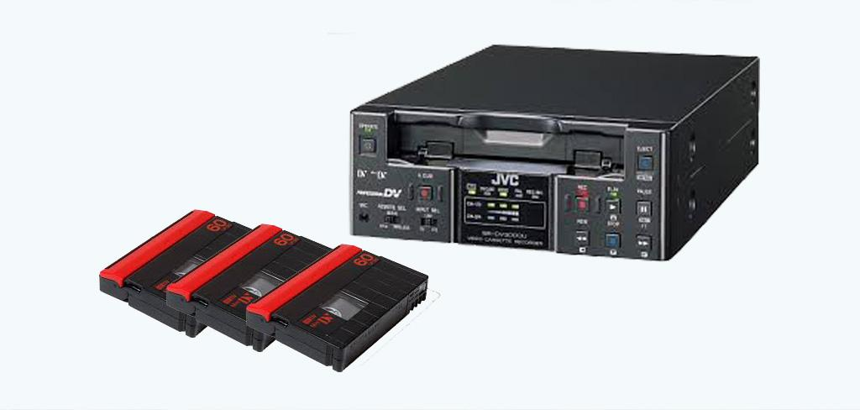
DVRescue
DV (Digital Video) is analog.
Tape will not last forever.
Players are disappearing...
FRAME Tech 2021 — Online Training Session

Slide 47
DVRescue
DVRescue supports improving DV files that have already been created by allowing such files to be assessed, so that the software may selectively retry portions of the tape and incorporate any improvements into the existing file.
FRAME Tech 2021 — Online Training Session

Slide 48
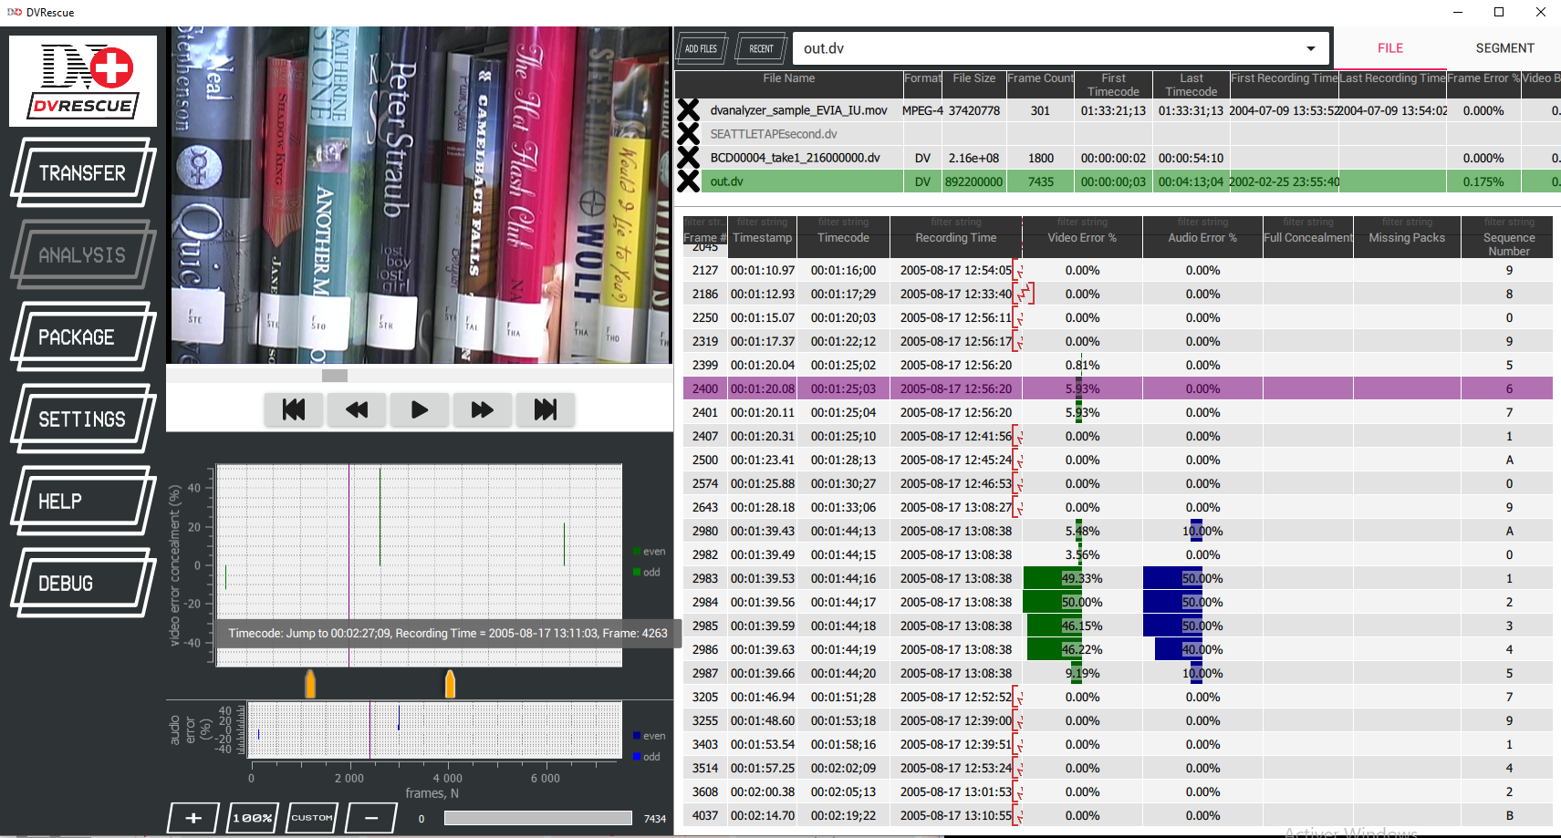
DVRescue
FRAME Tech 2021 — Online Training Session

Slide 49
DVRescue
Help in DV tape dump automation
Automate tape to file
Automatically cut the file depending on aspect ratio change, non consecutive timecode…
Show a table with a list of detected errors per frame
Merge 2 inputs in a better content, peeking good blocks from each file
FRAME Tech 2021 — Online Training Session

Slide 50
DVRescue
Still work in progress
Automation of the rewind and dump again when a problem is detected during dump of the tape
FRAME Tech 2021 — Online Training Session

Slide 51
RAWcooked
FRAME Tech 2021 — Online Training Session

Slide 52
RAWcooked
The issue with raw A/V files
Huge size (4K+ is there, can be 100 MB/frame, several TB per hour)
1 file per video frame (thousands of files in a directory)
Not playable as is by several players (VLC...)
So many DPX or TIFF format flavors (interoperability issues)
FRAME Tech 2021 — Online Training Session

Slide 53
RAWcooked
But… FFV1
Lossless video compression format
Open source, patent free
Adopted by several archives
Standardized (IETF, RFC 9043)
Frames are divided by slices, with checksums
FRAME Tech 2021 — Online Training Session

Slide 54
RAWcooked
Compression!
Example with 1 second at 24 fps 10-bit HD film on a 6-core (12-thread) Skylake-X CPU:
24 DPX files (or in ZIP/TAR uncompressed): 189 MB
1 compressed ZIP file: 175 MB in 10 seconds
1 compressed LZMA2 file: 154 MB in 30 seconds
1 FFV1/MKV Intra 16-slice file: 105 MB in 1.5 seconds
FRAME Tech 2021 — Online Training Session

Slide 55
RAWcooked
Advantages
Open source and free (FFmpeg)
Package is 1.5-3x smaller than DPX/TIFF
Checksum by "Cluster" (usually 1 second) at container level
Checksum by "Slice" (you choose how many per frame) at video level
Files are natively playable by several players (VLC, FFplay...)
FRAME Tech 2021 — Online Training Session

Slide 56
RAWcooked
Disadvantages of FFV1 alone
You lose some metadata
(DPX/TIFF header: scan software, some colorimetry info, film type, DPX time code, shutter angle, gamma...)
Complicated command line
But...
FRAME Tech 2021 — Online Training Session

Slide 57
RAWcooked
A new tool
Easy: just a short command line: "rawcooked YourDirectoryName"
Store DPX/TIFF headers/footers in a specific Matroska attachment
Store other sidecar files as Matroksa attachments
Output is a single Matroska/FFV1/FLAC file
Encoding is reversible (bit-by-bit to original files): "rawcooked YourMatroskaFileName.mkv"
Integrated quality management "rawcooked --all YourDirectoryName" adds hash of input files,
check the conformance of DPX, check that the files can correctly reverted...
FRAME Tech 2021 — Online Training Session

Slide 58
RAWcooked
Use case
Archive asks a digitalization to their supplier: classic workflow with the scanner + "rawcooked --all YourDirectoryName"
Transport... (2x less file sizes, less costly)
Archive receives content & checks the integrity: "rawcooked --check YourMatroskaFileName.mkv"
Archive can visually check the content with e.g. VLC Media Player
Storage (cost divided by 2 due to compression)
Revert to exact original DPX if someone needs it: "rawcooked YourMatroskaFileName.mkv"
FRAME Tech 2021 — Online Training Session

Slide 59
RAWcooked
Work in progress, always
Lack of GUI
New features planned: error correction codes, speedup improvements...
FRAME Tech 2021 — Online Training Session

Slide 60
RAWcooked
Users:
AV Preservation by reto.ch (main sponsor)
National Audiovisual Centre Luxembourg (CNA)
National Library of Norway
Irish Film Institute (IFI)
Northwest University Library
National Library of Wales
Walter J. Brown Media Archives
The MediaPreserve
British Film Institute
FRAME Tech 2021 — Online Training Session

Slide 61
RAWcooked
A different way to do open source
Open source code provided without lock to sponsors
Deliveries on our website are with a lock
DPX 8/10 bit RGB & WAV 2ch 48kHz flavors are usable by default
We provide a key for other format flavors and features (temporary key possible)
1000 € for first flavor/feature
+ 500 € per additional flavor/feature
To be compared with storage cost saving (storage cost divided by 2)
FRAME Tech 2021 — Online Training Session

Slide 62
Some other tools
FRAME Tech 2021 — Online Training Session

Slide 63
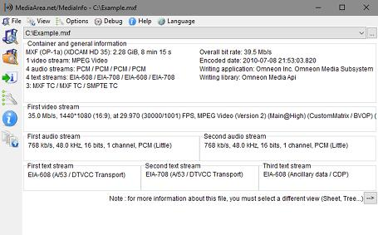
MediaInfo
Convenient unified display of the most relevant technical and tag data for video and audio files.
Output: text, XML, HTML, PBCore, EBUCore, NISO Z39.87...
Container: format, profile, commercial name of the format, duration, overall bit rate, writing application and library, title, author, director, album, track number, date, duration...
Video: format, codec id, aspect, frame rate, bitrate, color space, chroma subsampling, bit depth, scan type, scan order...
Audio: format, codec id, sample rate, channels, bit depth, language, bit rate...
Text: format, codec id, language of subtitle...
Chapters: count of chapters, list of chapters...
FRAME Tech 2021 — Online Training Session

Slide 64
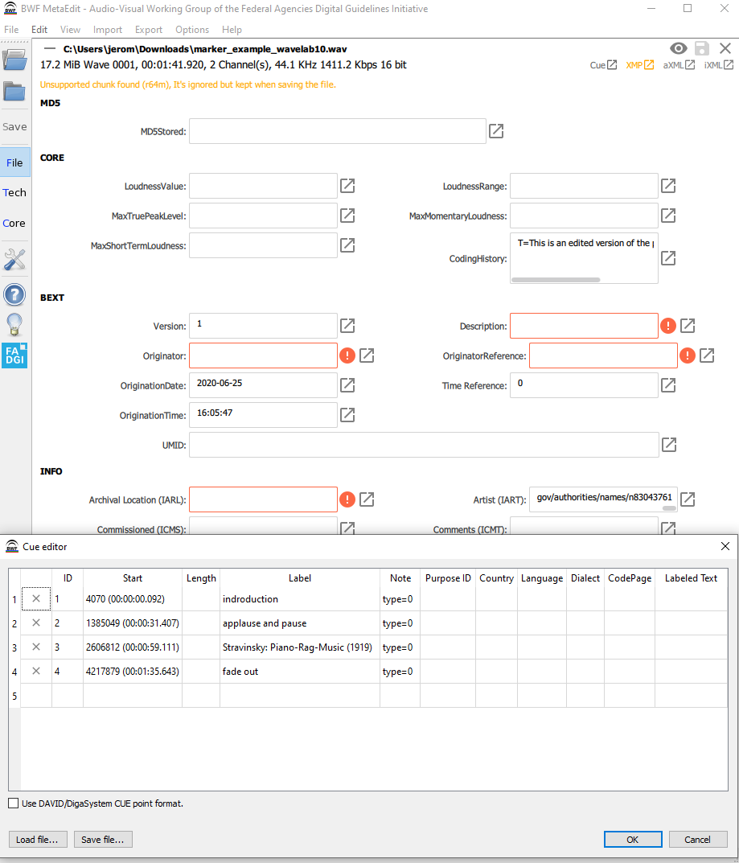
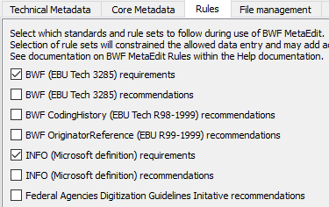
BWF MetaEdit
Supports embedding, validating, and exporting of metadata in Broadcast WAVE Format (BWF) files.
It supports the FADGI Broadcast WAVE Metadata Embedding Guidelines.
Last version includes a Cue Editor
FRAME Tech 2021 — Online Training Session

Slide 65
Platform support
FRAME Tech 2021 — Online Training Session

Slide 66
Platform support
We try to support as many platforms as possible:
Windows 7+
macOS 10.10+
Debian 8+
Ubuntu 16.04+
CentOS/RHEL 7+
openSUSE/SLE 12+
CPU: x86, x86_64/x64, ARM (including Apple M1),...
FRAME Tech 2021 — Online Training Session

Slide 67
How was it created?
FRAME Tech 2021 — Online Training Session

Slide 68
How was it created?
By users for users!
Each tool started from the need of a user.
MediaArea is here to technically help, but users are at the driver seat.
No restriction on the usage
(with one exception with RAWcooked binaries)
FRAME Tech 2021 — Online Training Session

Slide 69
Stay in touch
http://mediaarea.net jerome@mediaarea.net
License (except images): CC-BY
FRAME Tech 2021 — Online Training Session

